Slide 1

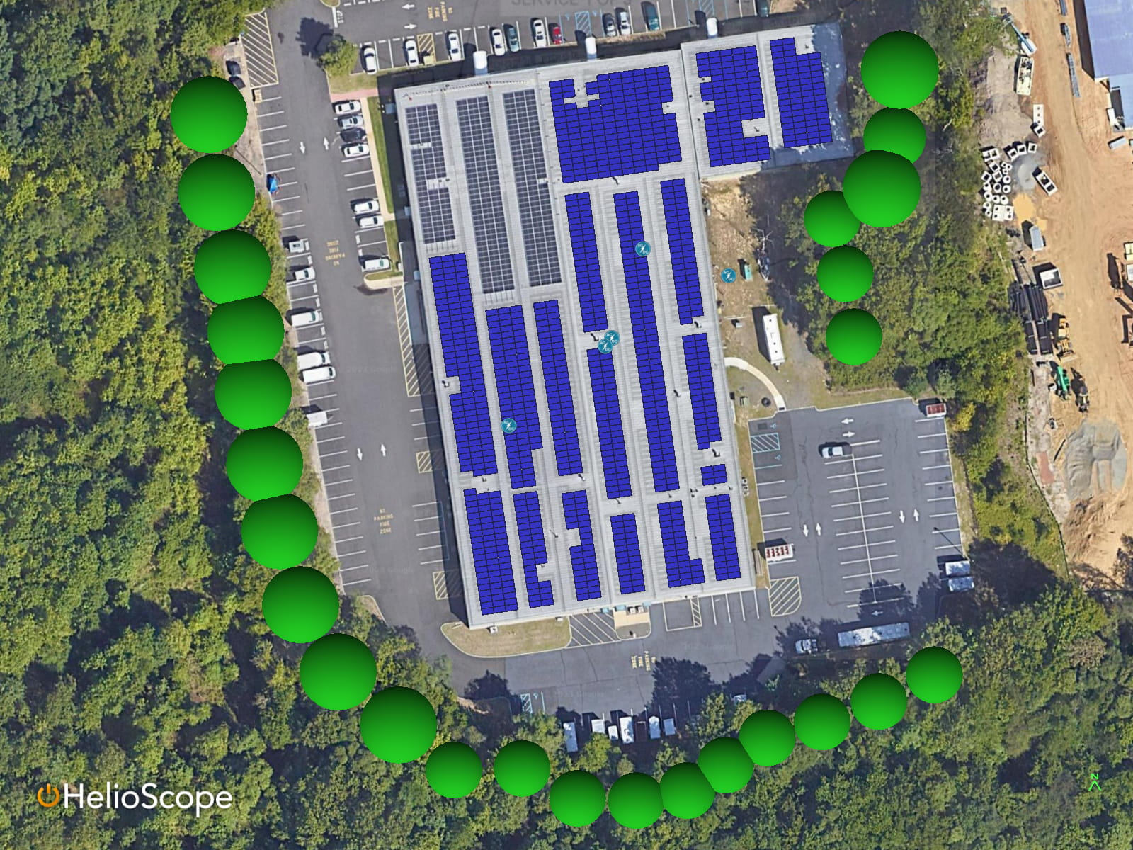
Created: 2025-10-23 03:49:10
AutoCIM Demo - Project Overview
Project Characteristics
Notes
Project Name | AutoCIM Demo | Ecosuite, Inc.
Location | Brooklyn, NY | New York
Project Size (AC Size) | 480 kW
Project Size (DC Size) | 650.16 kW
Status | Pre-Construction
Revenue Source | Community Solar Income, Grant, SREC Revenue
NTP Goal | 2025-06-27
Milestone
Date
Status
Project Initiated | January 22, 2021 | Completed
Interconnection Application | March 31, 2022 | Completed
Permitting Phase | May 24, 2023 | Completed
Pre-Construction | June 17, 2024 | Completed
Construction Start | March 26, 2025 | Completed
Notice to Proceed (NTP) | June 27, 2025 | Completed
Operational | July 24, 2025 | Completed
1

Slide 2
Model Inputs - CAPEX
Budget ($)
Actual
ITC
Budget ($)
Actual
ITC
EPC - Solar Installation | — | $965,750 | —
BOS/Labor/Construction |  | $627,016 | —
Inverters |  | $64,657 | —
Modules |  | $75,002 | —
Monitoring System |  | $12,500 | —
Other Equipment |  | $125,000 | —
Racking |  | $51,726 | —
Site Improvement |  | $9,849 | —
Soft Costs | — | $149,248 | —
Construction Financing |  | $36,940 | —
Construction Insurance |  | $8,082 | —
Legal, Accounting, Audit Expenses |  | $8,000 | —
Permanent Financing |  | $40,000 | —
Site Control |  | $4,500 | —
Software Implementation |  | $3,233 | —
Subscriber Acquisition |  | $48,493 | —
Engineering | — | $17,850 | —
Electrical Design |  | $1,681 | —
Mechanical Design |  | $194 | —
PE Stamp |  | $1,900 | —
QA/QC Fees |  | $3,673 | —
Site Surveying |  | $2,000 | —
Structural |  | $8,402 | —
Interconnection Costs | — | $45,476 | —
Application/Study Fees |  | $9,699 | —
Construction |  | $35,778 | —
Permitting | — | $31,503 | —
Application Materials |  | $1,000 | —
Expeditor |  | $7,500 | —
Town Fees |  | $23,003 | —
Grand Total | — | $1,209,827 | —
5

Slide 3
Model Inputs - Revenue
Start Rate
Term
Start Date
Frequency
Escalator
Community Solar Income
Back-End Revenue | $0.21 | 15yr | 2045-07-30 | monthly | 3.5%
Energy Compensation Rate 1 | $0.10 | 20yr | 2025-08-11 | monthly | 2%
Energy Compensation Rate 2 | — | 20yr | 2025-08-11 | monthly | —
Grant
Grant 1 | — | — | — | — | —
Grant 2 | — | — | — | — | —
SREC Revenue
SRECs | — | 16yr | 2025-08-11 | quarterly | —
Grand Total | $0.31
6

Slide 4
Model Inputs - OPEX
Start Rate
Term
Start Date
Frequency
Escalator
Accounting
Administration & Accounting | $5,000.00 | 20yr | 2025-08-11 | monthly | 2%
Equipment Replacement
Equipment Replacement | $1,616.43 | 20yr | 2025-09-11 | monthly | —
Insurance
Insurance | $6,465.70 | 20yr | 2025-05-01 | annually | —
O&M - contracted
O&M - Contracted | $2,909.57 | 20yr | 2026-01-01 | quarterly | 2%
O&M - uncontracted
O&M - Uncontracted | $3,232.85 | 15yr | 2030-08-11 | quarterly | 2%
Other Business Expenses
Blank 2 | — | 20yr | 2025-08-11 | monthly | —
PowerMarket Ongoing Management | $5,172.56 | 20yr | 2025-08-11 | monthly | —
Site Lease
Site Lease | $12,500.00 | 20yr | 2025-08-11 | annually | 1%
Taxes & Licenses
Property Tax | — | 20yr | 2025-08-11 | annually | 2%
Grand Total | $36,897.10
7

Slide 5
Development Budget Detail
Budget ($)
Actual
ITC
Budget ($)
Actual
ITC
Development Fee | — | $757,286 | —
Account Mgmt |  | $42,711 | —
Administration |  | $6,058 | —
As-Built |  | $2,878 | —
Bid Set |  | $15,146 | —
Bidding & Contract |  | $11,359 | —
Construction |  | $10,451 | —
Construction Set |  | $14,237 | —
Contractor Mgmt |  | $3,862 | —
Financing |  | $20,901 | —
Financing & Dilligence |  | $11,359 | —
Host Customer Acquisition |  | $19,917 | —
Interconnection (Project Side) |  | $17,115 | —
IX Design (Project Side) |  | $5,680 | —
Margin |  | $495,113 | —
Permitting |  | $22,794 | —
Permitting Set |  | $9,466 | —
Procurement Mgmt |  | $8,557 | —
Site Control |  | $12,041 | —
Site Mgmt |  | $18,932 | —
Site Review |  | $8,709 | —
Grand Total | — | $757,286 | —
8

Slide 6
Underwriting and Project Summary
Item
Status
Item
Status
1. Interconnection
Section
Other
○ Pending
Interconnection Complexities
○ Pending
Confirm if Property is Tax Exempt
○ Pending
Other
○ Pending
Wetlands Permit (if applicable)
✓ Completed
Executed ISA
○ Pending
Wetlands Map (if applicable)
✓ Completed
25% Interconnection Proof of Payment
○ Pending
SEAF (NY) or Other Environmental Permits (if applicable)
✓ Completed
Wireless Meter Signal Test and Payment (if applicable)
✓ Completed
Historic/Landmark District Approval (if applicable)
✓ Completed
2. Legal/Site Control Items
Section
Initiate Construction Financing (12-weeks prior to NTP)
○ Pending
Recorded Memorandum of Lease
✓ Completed
Screening/Buffer Plan (if applicable)
✓ Completed
Other
○ Pending
Qualifying Facility Self-Certification
✓ Completed
Title Report
✓ Completed
Tree Removal Permit (if applicable)
✓ Completed
Foreign LLC Registration (if applicable)
✓ Completed
FAA Determination
○ Pending
Initial Roof Warranty (if available)
○ Pending
Structural Plan/Analysis (if applicable)
✓ Completed
LLC Operating Agreement
✓ Completed
Stamped Permitting Set
○ Pending
Bonus Payment(s) Issued (if applicable)
✓ Completed
Erosion Control Plan (if applicable)
✓ Completed
Recorded Subordination and Non Disturbance Agreement (SNDA) (if applicable)
✓ Completed
Pre-Construction Deal Approval (if required)
○ Pending
Site Lease Agreement
✓ Completed
Geotechnical Plan (if applicable)
✓ Completed
3. Permitting
Section
PILOT Agreement (if applicable)
○ Pending
Decommissioning Bond (if applicable)
✓ Completed
Site Existing Conditions Survey (if applicable)
✓ Completed
Verify Procurement & Construction Schedule alignment
○ Pending
Draft 128 Form (if applicable)
✓ Completed
2

Slide 7
Underwriting and Project Summary
Item
Status
Item
Status
Zoning Decision (if applicable)
○ Pending
Title report
○ Pending
Special Use Permit (if applicable)
○ Pending
Executed 128 Form
✓ Completed
4. Pre-Construction
Section
Executed Exercise Notice
○ Pending
Trigger Appraisal - Internal & External
○ Pending
Add Daily Reports Shortcut to Engineering Drive
○ Pending
EPC/Construction Agreement
○ Pending
Property Owner Certificate of Insurance
○ Pending
Other
○ Pending
NTP Financial Model
○ Pending
Construction Permits
○ Pending
Contractor Certificate of Insurance
○ Pending
Confirm Additional Utility Program Participation
○ Pending
W-9's
○ Pending
Production Estimate
○ Pending
SolarEdge Site Created and Shared
○ Pending
Notfiy Marketing of NTP
○ Pending
Ecosuite Certificate of Insurance
○ Pending
Bonus Payment(s) Issued (if applicable)
○ Pending
Project Listed in Ecosuite Insurance SOV (Construction)
○ Pending
Fire Department Approval (if applicable)
○ Pending
Equipment Deliveries Scheduled
○ Pending
Subsequent ISA Proof of Payments (75%)
○ Pending
Site Specific Safety Plan
○ Pending
First Rent Payment Issued
○ Pending
Duration Based Construction Schedule
○ Pending
Request QA/QC Quotes
○ Pending
FAA Supplemental Form
○ Pending
Roof Warranty Requirement Research
○ Pending
Trigger Internal Financial Closeout Document Drafting
○ Pending
Request Egress Switch (if applicable)
✓ Completed
5. PPA
Section
Construction Financing Secured
○ Pending
Executed Power Purchase Agreement
✓ Completed
NTP Email
○ Pending
Offtaker Historic Energy Bills
✓ Completed
3

Slide 8
Underwriting and Project Summary
Item
Status
Offtaker Financials
✓ Completed
Net Metering Application (if applicable)
✓ Completed
6. Community Solar
Section
Trigger Customer Acquisition Partner Agreement (if applicable)
○ Pending
Qualifying Facility Self-Certification
✓ Completed
Trigger Net Crediting/Subscriber List sent to utility
○ Pending
Community Solar Incentive Application
✓ Completed
Community Solar Management Agreement/SOW
○ Pending
7. FIT
Section
Incentive Application
✓ Completed
NRES Tariff Agreement (if applicable - all CT projects)
✓ Completed
Eligible Energy Resource Application (if applicable - all RI projects)
✓ Completed
8. SREC
Section
REC Registration
○ Pending
REC Final Approval
○ Pending
REC Application
○ Pending
REC Conditional Approval
✓ Completed
4

Slide 9
Contact Information
Ecosuite
info@ecosuite.io
Brooklyn, New York
https://ecosuite.io
Disclaimer
This presentation, including any documents, files, or attachments, is intended solely for the use of the designated recipient(s) and may contain privileged and confidential information.
Any unauthorized review, use, disclosure, distribution, or copying of its contents is strictly prohibited.
If you have received this presentation in error, please notify the sender immediately by replying via email and delete all copies of this communication and its attachments without reading, printing, or saving them in any manner.
© 2025 Ecosuite. All rights reserved.
9

